Slide 1
Sneaker Classification
By: Shahan Rahman, Hasibul Islam, Jun Zheng & Carlos Vides

Slide 2
Problem To Solve
Given still images of a sneaker, identify or verify one or more sneaker companies in the image using a stored database of sneakers.

Slide 3
Why We Want To Solve It
We all been there when you looked at a pair of shoes and didn’t know what they are. This is why we want to create a program to help us identify any sneaker.

Slide 4
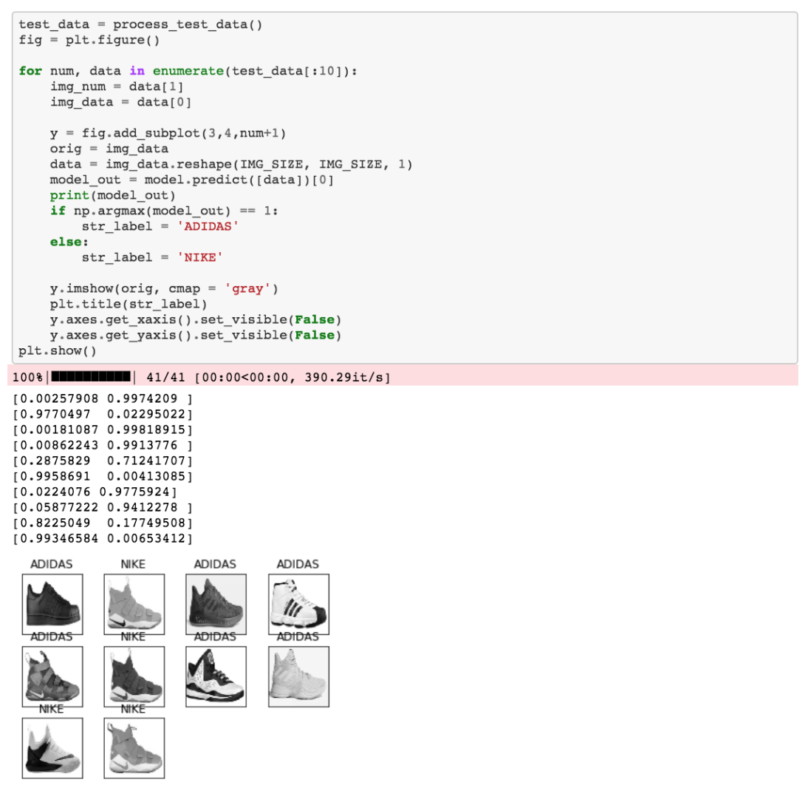
Similar Projects
A project that is similar is Connor Shorten, who created a convolutional network classifier between Nike vs Adidas. This article shows us how he went about creating this program and how his machine learning algorithm learnt from the database.

Slide 5
Our Method To Solve This Problem
Our method to solve this problem is create a Convolutional neural network for image classification. This would help improve time to learn and less data heavy to train the model. Also there are many scholarly articles to help identify clothes and shoes.

Slide 6
Our Data Set
Our data set will come from sole collector which has all brands and different sub categories for each brand. We would then have a training set that will have the correct shoe and brand name as the file name.
Notes:
https://solecollector.com/sd/sole-search-sneaker-database/

Slide 7
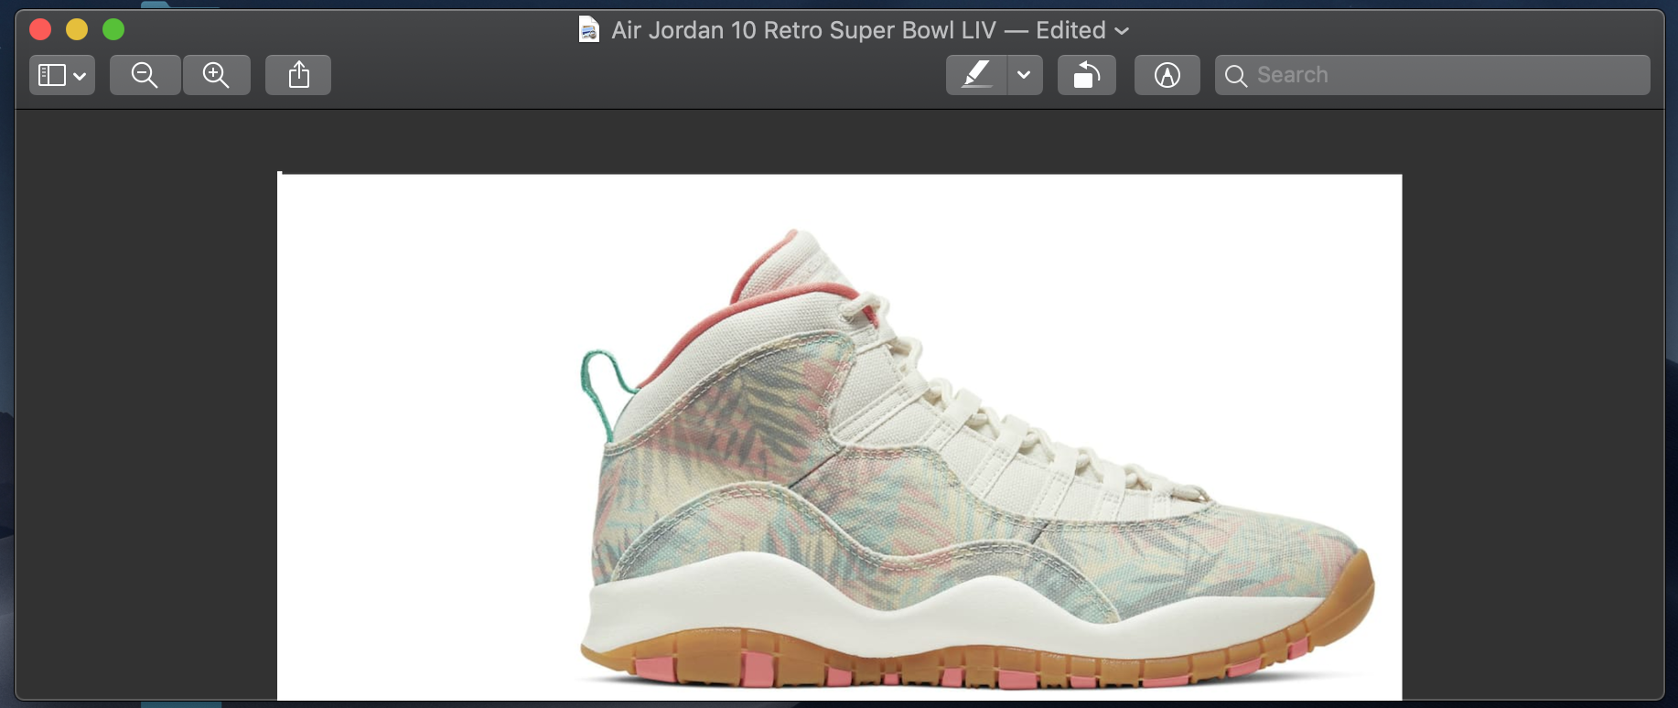
Example Of Data Set
An example of the data set looks like this:
Notes:
https://solecollector.com/sd/sole-search-sneaker-database/

Slide 8
Sketch of Program
The sketch of the program would consist of two folders where one folder would hold the data set consisting of test and training data. Then the other folder would hold the main program files. We are deciding on putting the program on google colab and having a repo of the project on github.

Slide 9
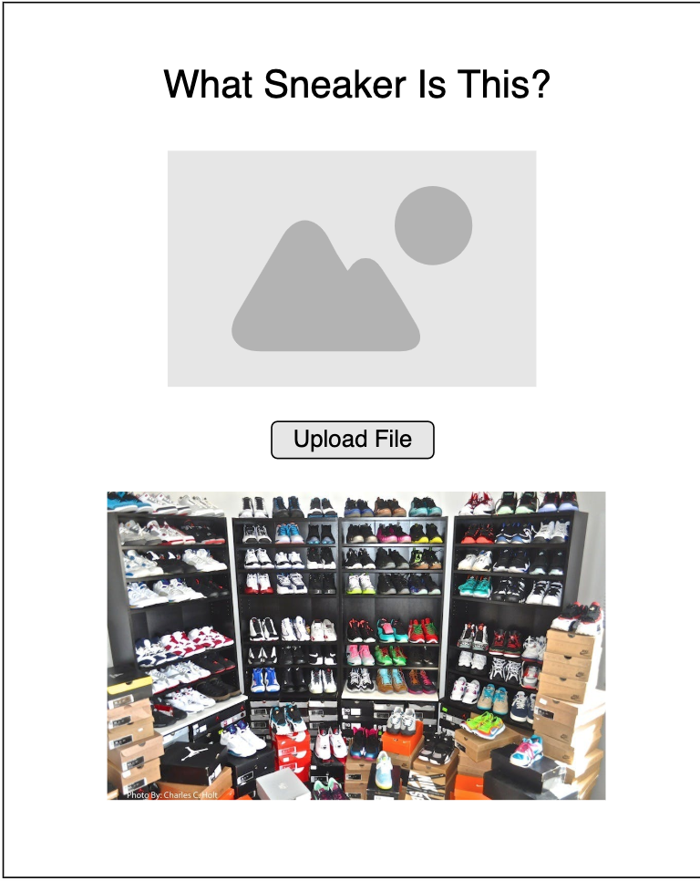
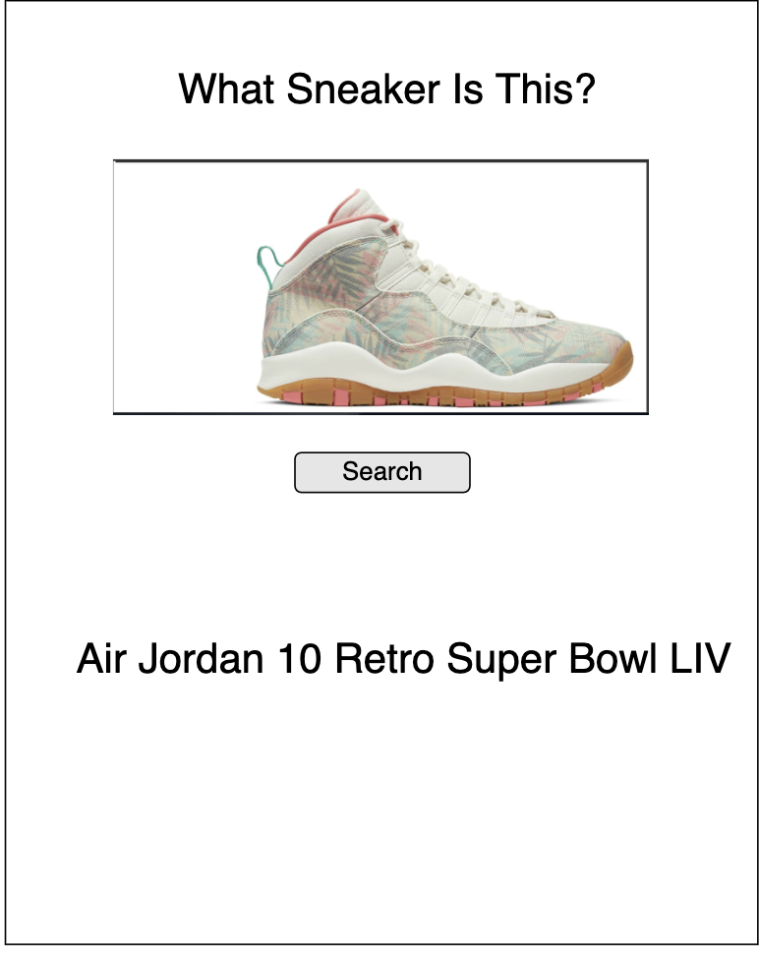
Sketch of Program

Slide 10
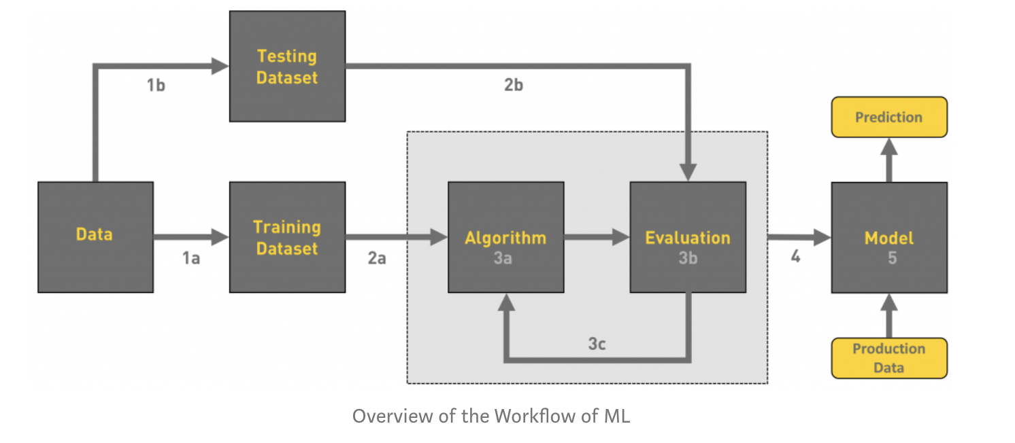
What we plan to do between today and next meeting?
Gathering Data (Koggle.com, https://datasetsearch.research.google.com/ , Google Images)
Data Pre-Processing (Cleaning Data, 80/20 Rule)
Open up a github workflow environment for the team
Decide whether it would be a mobile or a web application
Sort out the workload between all 4 members

Slide 11
Thank YOU!

